Slide 1
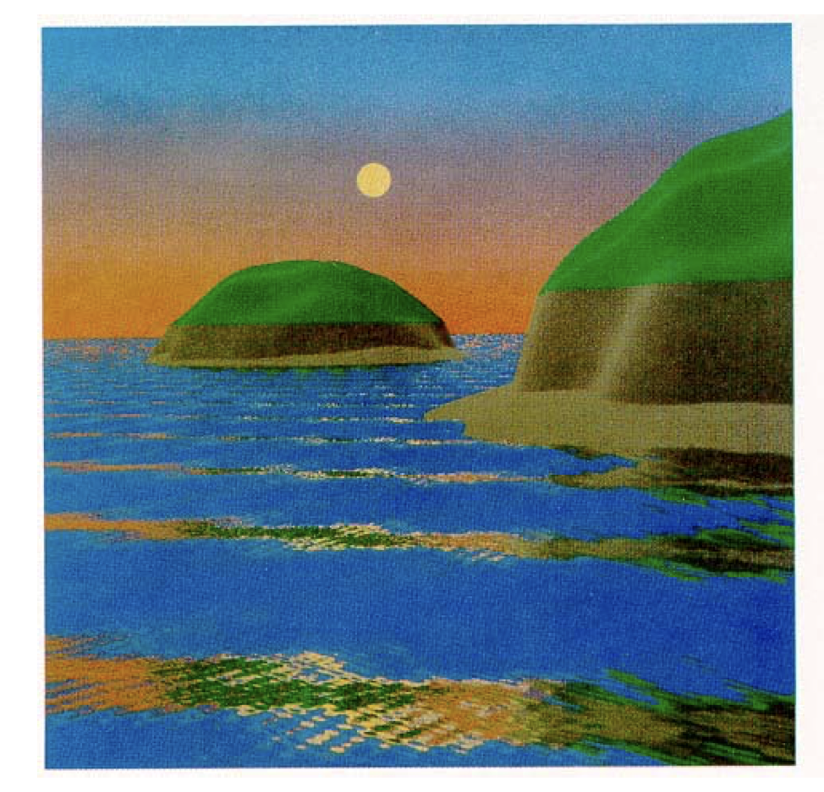
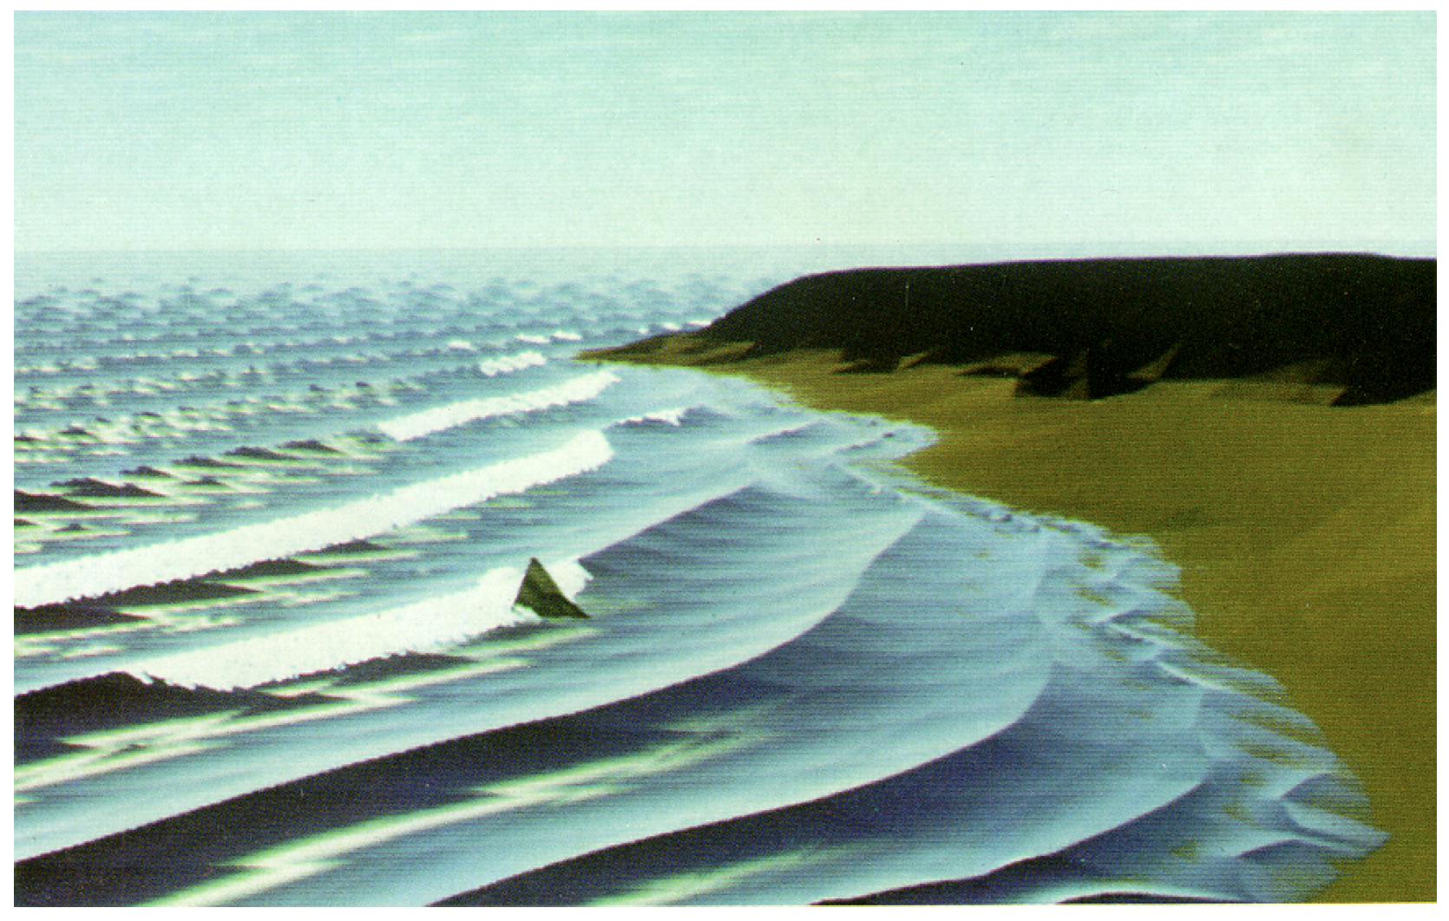
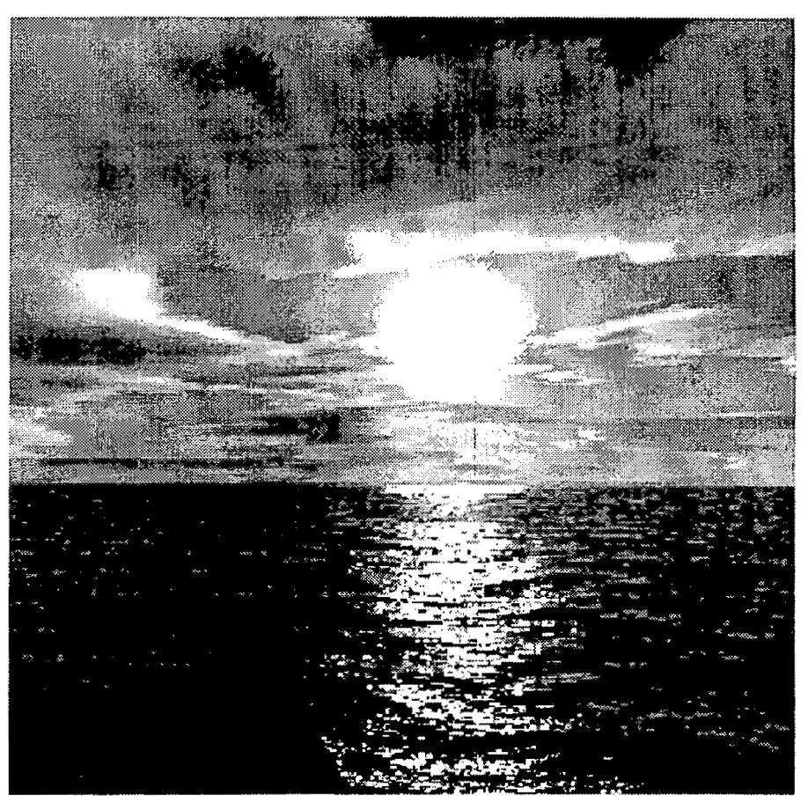
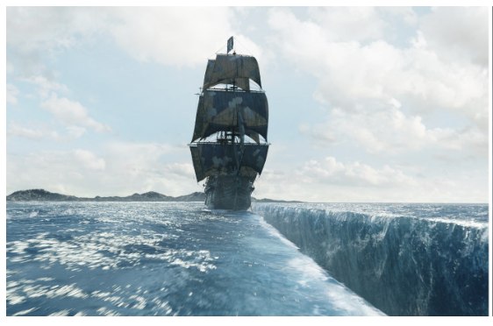
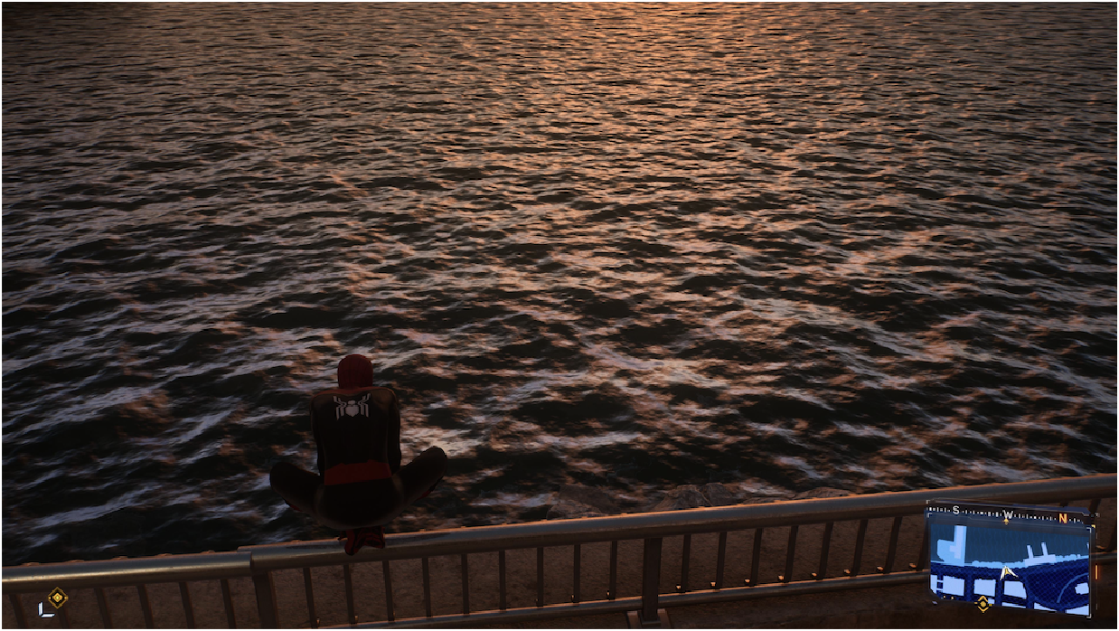
EEE 598 HW 0
Niraj Anil Babar
1986 SIGGRAPH [2]
1981 SIGGRAPH [1]
2000 [3]
Motivation for choosing water
Spiderman 2 game (Released 2023)
2017 SIGGRAPH [4] Pirates of Caribbean
Nelson L. Max. 1981. Vectorized procedural models for natural terrain: Waves and islands in the sunset. SIGGRAPH Comput. Graph. 15, 3 (August 1981), 317–324.
Darwyn R. Peachey. 1986. Modeling waves and surf. SIGGRAPH Comput. Graph. 20, 4 (Aug. 1986), 65–74.
S. Premoze and M. Ashikhmin, "Rendering natural waters," Proceedings the Eighth Pacific Conference on Computer Graphics and Applications, Hong Kong, China, 2000, pp. 23-434, doi: 10.1109/PCCGA.2000.883856.
Rob Hopper and Kai Wolter. 2017. The water effects of Pirates of the Caribbean: Dead Men Tell no Tales. In ACM SIGGRAPH 2017 Talks (SIGGRAPH '17). Association for Computing Machinery, New York, NY, USA, Article 31, 1–2.

Slide 2
History and motivation on rendering water
I chose rendering water as the focus for this HW as I play games and I have seen how the rendering of water in games has improved over the years. The spiderman image on first slide is a screenshot from the game I played and it shows water in a very realistic way.
Water rendering techniques started out as simple visual tricks and gradually became more realistic and physically inspired. In the early 1980s, water was usually shown as a flat surface or a basic height-field with bump mapping and simple wave patterns. These methods could make water look wavy, but they did not handle realistic shapes, refraction, or how waves interact with land. By the late 1980s and early 1990s, realism improved as artists and researchers used better wave models and added effects like wave bending near shores, as well as particle systems to create foam, spray, and breaking waves. During the 1990s, water rendering advanced even more with techniques such as environment mapping and texture-based reflection and refraction, along with early fluid simulation methods based on simplified physics and Navier–Stokes equations. By the late 1990s, water rendering had become a mix of geometry, particles, textures, and physics-based simulation, making animated water look and behave much more like real water, interacting naturally with light, terrain, and objects.
Rendering water went from being rendered as a static texture to a time-dependent system, using height fields, particle systems, and later PDE and Navier–Stokes–based solvers.
The 4 images I picked showed how water rendering has progressed throughout the years.

Slide 3
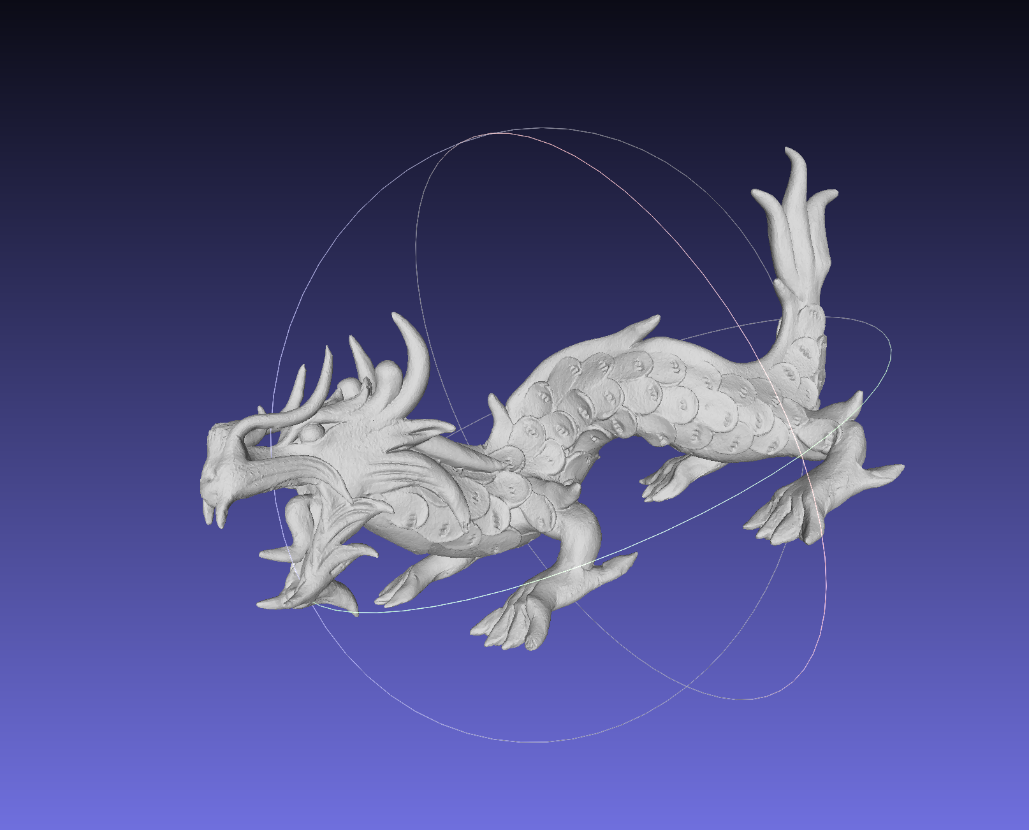
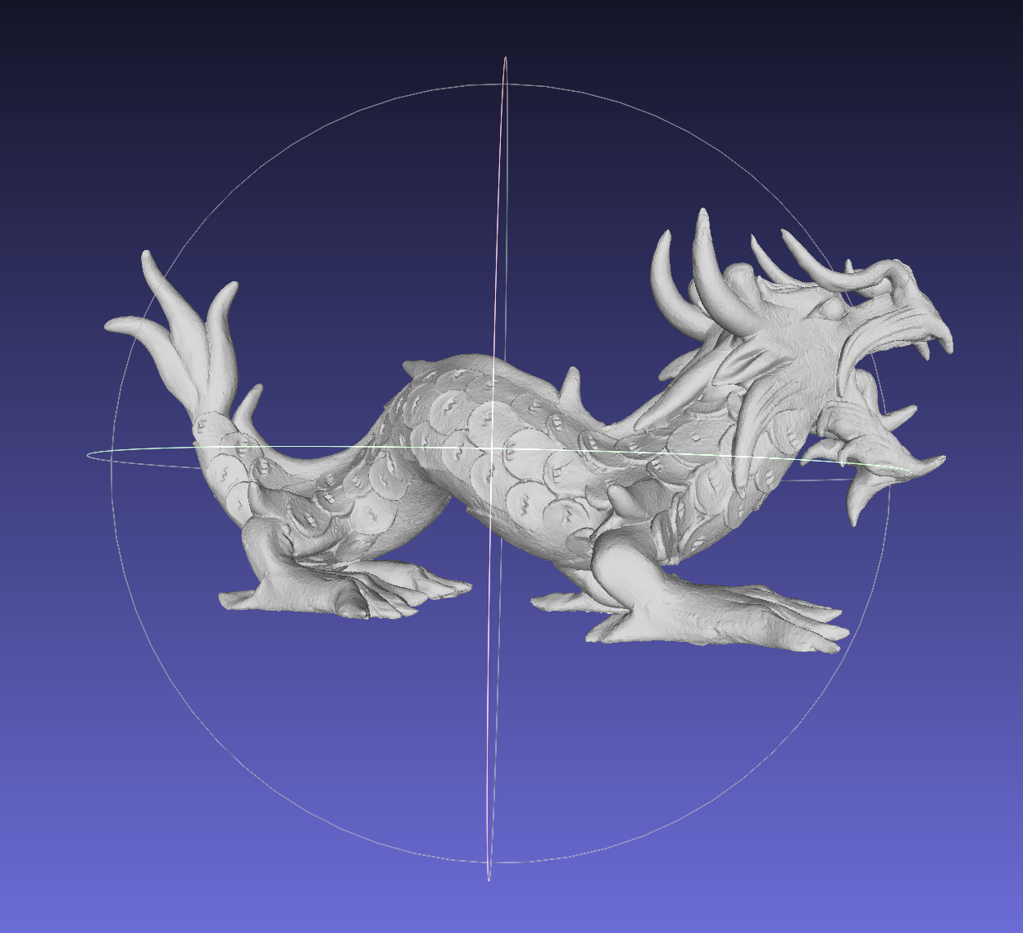
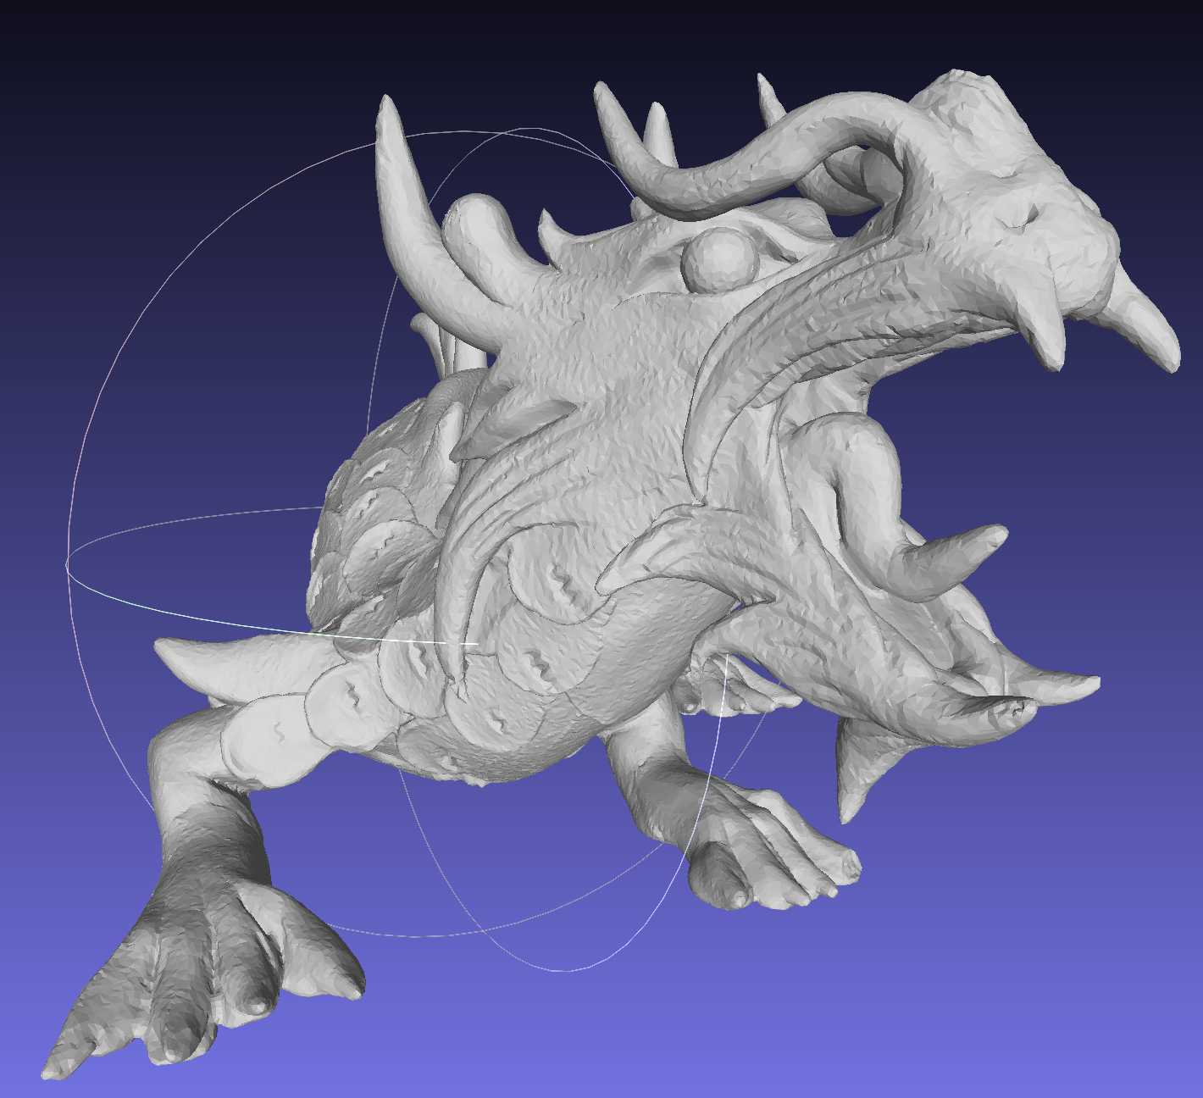
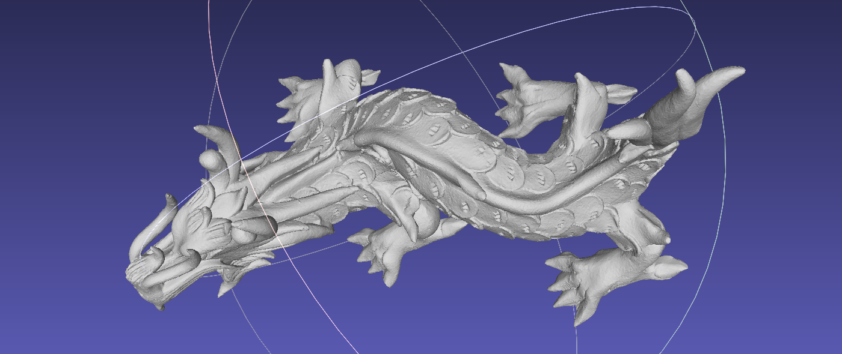
Meshlab
Dragon.obj

